Slide 1


Slide 2
CK Group
Specialist Pharmaceutical, Life Sciences and Chemical Recruitment Agency
Services include:
Permanent recruitment
Contract/outsource recruitment
PAYE, PSC/Ltd company/Umbrella
UK/Ireland/Switzerland/Belgium/Holland/US

Slide 3
Continual Changes
AWR
GDPR
Brexit
IR35

Slide 4


The Speakers:
Lewina Farrell - Head of Legal Services at the Recruitment and Employment Confederation
Chris Humphreys - Tax Partner, Barber Harrison & Platt, Chartered Accountants

Slide 5
Preparing for IR35
CK Group 7 November 2019

Slide 6
Extension of the off-payroll rules to the private sector
Lewina Farrell
Head of Legal Services, REC
Notes:
Thank you for joining us today.
In the following slides I will look at:
When do the rules changes?
What organisations will the off payroll rules apply to and what organisations will they not apply to?
Who has to pass what decisions to whom, and when?
Liability – who will be liable for unpaid tax and NICs in what circumstances
Impact on employment status
Other consequences

Slide 7
DISCLAIMER: All comments and advice given in this seminar and in this presentation are generic advice based on the Government’s draft legislation and related documents published on 11 July 2019. A technical consultation on the draft legislation closed on 5 September 2019.
REC will keep members updated throughout 2019/ 20 on developments. Please watch our IR35 hub for updates.
This presentation is not a substitute for detailed legal advice.
Notes:
You won’t find the terms “inside” or “outside” IR35 in the legislation (nor indeed IR35)
Revenue loss – including as a result of significant growth in PSCs (or intermediaries that look like PSCs).

Slide 8
IR35 and the off-payroll rules – a brief history
IR35 introduced in April 2000. Chapter 8 of the Income Tax (Earnings and Pensions) Act 2003 (ITEPA).
Purpose: collection of employment tax from those working through intermediaries.
How: Where an individual works through an intermediary, such as a personal services company, if that intermediary did not exist and the individual “looked” like an employee of the client they provide their services to they are “inside IR35”, i.e. they should be taxed as an employee. If “outside IR35” then they are self-employed for tax purposes.
Intermediary responsible for tax status decision and relevant deductions but no single test to assess status. Various IR35 cases over the years – mixed results.
2016 - Government believed there was significant revenue loss as a result of non-compliance with IR35.
Notes:
You won’t find the terms “inside” or “outside” IR35 in the legislation (nor indeed IR35)
Revenue loss – including as a result of significant growth in PSCs (or intermediaries that look like PSCs).

Slide 9
The off-payroll rules in the public sector
From 6 April 2017 – the off-payroll rules apply where the client is a public authority as defined in the Freedom of Information Act 2000 or Freedom of Information (Scotland) Act 2002. Chapter 10 ITEPA.
Shifted the responsibility for IR35 status decision from the intermediary to the client.
If it is an ‘inside IR35’ engagement the fee-payer will be required to make appropriate tax and NICs deductions. Employers’ NICs will also be due. Report on deductions via Real Time Information.
If it is an ‘outside IR35’ engagement the intermediary remains responsible for any deductions. Employment business reports payment to the intermediary via quarterly ITEPA reports.
Notes:
Public authority = all govt. departments, local authorities, NHS trusts, schools including academies, research councils.
ow to check: do they need a “publication scheme” for FOIA purposes? Usually set out on their website.

Slide 10

Extension of the off-payroll rules to the private sector
In October 2018 Government stated that it would extend the off-payroll rules into the private sector from 06.04.20.
Consultation closed 28.05.19. Draft legislation and initial guidance published on 11.07.19. But budget postponed and election! Delay to final legislation?
Some amendments to existing off-payroll rules which will apply to all organisations affected.
Statutory payments and employment rights will not be affected by these changes.
Off-payroll rules will take precedence over managed service company legislation and CIS.
Notes:
In 2016/ 17 HMRC said that they had no plans to extend this to the private sector. However many of us believed that it would only be a matter of time before the reforms would be rolled out to the private sector – it would not be tenable to have different tax systems dependent on the nature of the client. The public sector would be a testing ground,. And so that is what happened. In early 2018 Govt. consulted on improving compliance within the private sector – a number of options, extension was just one. But all others have been ruled out.
Alignment of employment and tax status – “The government agrees that reducing the differences between the tax and rights frameworks for employment status to an absolute minimum is the right ambition, and will bring forward detailed proposals on how the frameworks could be aligned in due course.”
Page 20 - “the deemed employment relationship does not result in employment rights or statutory payments obligations for the deemed employer or fee-payer”.

Slide 11
Extension of the off-payroll rules to the private sector
NB – the IR35 rules/ tests are not changing but the administration of the rules are.
Notes:
In 2016/ 17 HMRC said that they had no plans to extend this to the private sector. However many of us believed that it would only be a matter of time before the reforms would be rolled out to the private sector – it would not be tenable to have different tax systems dependent on the nature of the client. The public sector would be a testing ground,. And so that is what happened. In early 2018 Govt. consulted on improving compliance within the private sector – a number of options, extension was just one. But all others have been ruled out.
Alignment of employment and tax status – “The government agrees that reducing the differences between the tax and rights frameworks for employment status to an absolute minimum is the right ambition, and will bring forward detailed proposals on how the frameworks could be aligned in due course.”
Page 20 - “the deemed employment relationship does not result in employment rights or statutory payments obligations for the deemed employer or fee-payer”.

Slide 12
Extension of the off-payroll rules to the private sector
What clients will the off-payroll rules apply to from 6 April 2020?
  Public sector – public authorities
  Private sector –medium and large organisations only (new Sections 60A to 60G ITEPA)
    But not small companies *, as defined in the Companies Act 2006 – i.e. a company which in a particular financial year meets two or more of the following conditions (current figures):
      (1) has a turnover of not more than £10.2 million,
      (2) a balance sheet total of not more than £5.1 million, or
      (3) not more than 50 employees.
    Companies in small groups and joint ventures will also be captured if the parent company or any parties in the JV are not small.
    Anti-avoidance provisions will ensure that parties connected to, associated with or controlled by the client cannot take advantage of the small company exemption.
  Where a small company is exempt, the existing IR35 rules (Chapter 8 ITEPA) apply i.e. responsibility for status decision and relevant deductions stays with the intermediary (e.g. PSC) .
* NB – the proposed exemption applies to end users only, not employment businesses who may also be small companies
Notes:
A small company is one which in a particular financial year meets two or more of the following conditions: (1) has a turnover of not more than £10.2 million, (2) a balance sheet total of not more than £5.1 million, or (3) not more than 50 employees (Employee test – average number of employees employed in a year).
So clients and agencies alike will need to know whether the client is a small company, and therefore exempt from the changes. Where the end-user client is a small company, the intermediary will still be responsible for administering the IR35 rules.
Small groups – defined in s383 Companies Act
The REC considers that the proposed exemption will impose a significant administrative burden on employment businesses and will push back on this.

Slide 13
Extension of the off-payroll rules to the private sector
Organisations which are not incorporated will be captured if they have turnover of £10.2 million or more.
Change in status for all organisations: Where an organisation becomes or ceases to be small in an accounting period, the change will apply from the start of the tax year following the end of that accounting period.
  NB – if a client becomes a small company, having already given a status decision, then it must withdraw that status decision. Existing IR35 rules (Chapter 8) will then apply, i.e. intermediary responsible for IR35.
In outsourced arrangements: HMRC have advised that the party to whom the service has been outsourced is the client and so must make the IR35 assessment. (NB – this is not stated explicitly in legislation – waiting for written guidance)
So, exempt or not?
  NB – a client is not required to tell the employment business that they are exempt because they are a small company.
  However if a client is not exempt, they will be liable (i.e. treated as the fee-payer) until such time as they pass on their status determination statement.
Notes:
Small companies test
Employee test – average number of employees employed in a year
Non-incorporated organisations:
2 options:
Apply the rules to organisations with 50 or more employees OR with turnover exceeding £10.2 million – so only need to meet one of the small company criteria
Apply the rules to organisations that have both 50 or more employees and turnover in excess of £10.2 million
(so in both scenarios avoiding the balance sheet condition. – don’t know why)
Again this is excessively complicated – option 1 will capture more organisations
In all of these scenarios the question is who makes the decision whether the company is exempt or not? Is the recruitment business to rely on a decision (or lack of decision) by the client? What if the client knows nothing about IR35 (shows need for comprehensive education programme).
When should this decision be made?
What happens if the decision is wrong?
What if the organisation does not tell whether it is a small company or not – good question and there is no answer to this in the consultation. We are raising it in our response document.

Slide 14
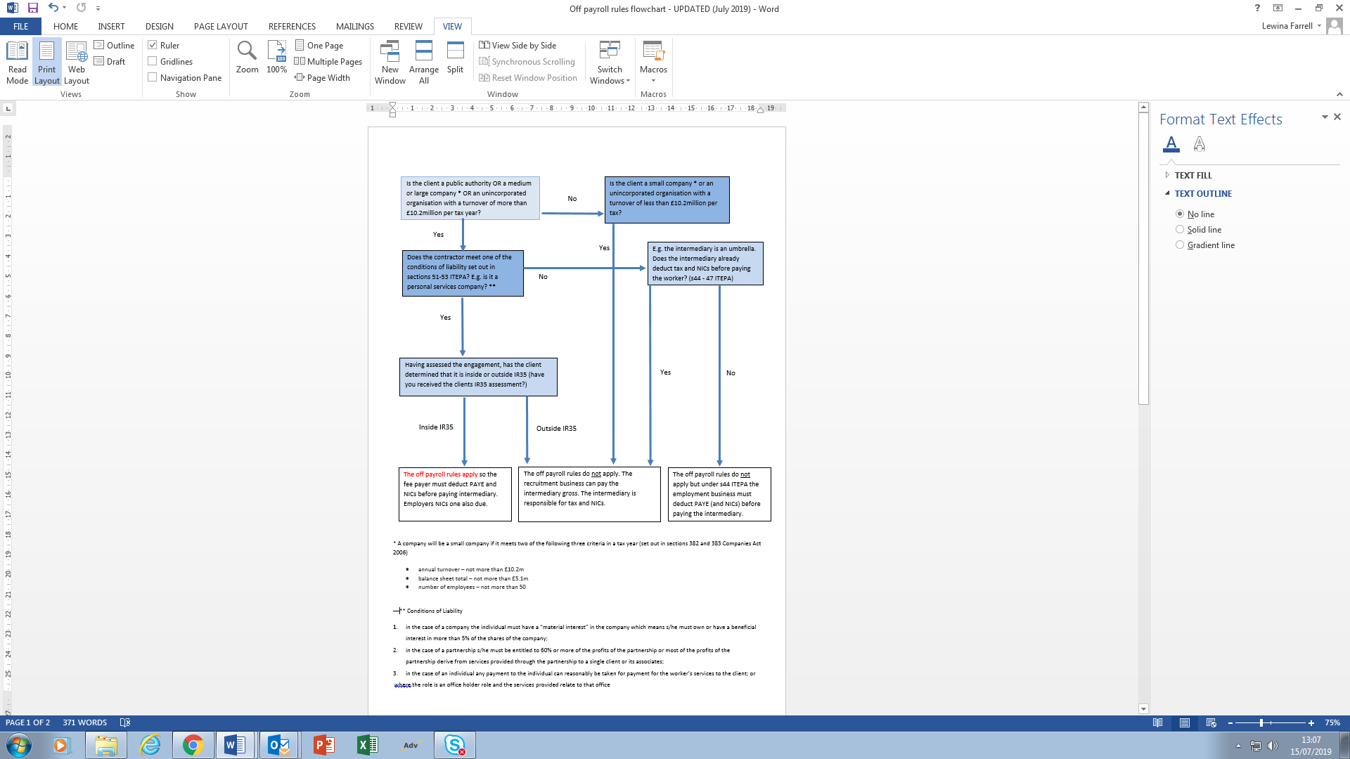
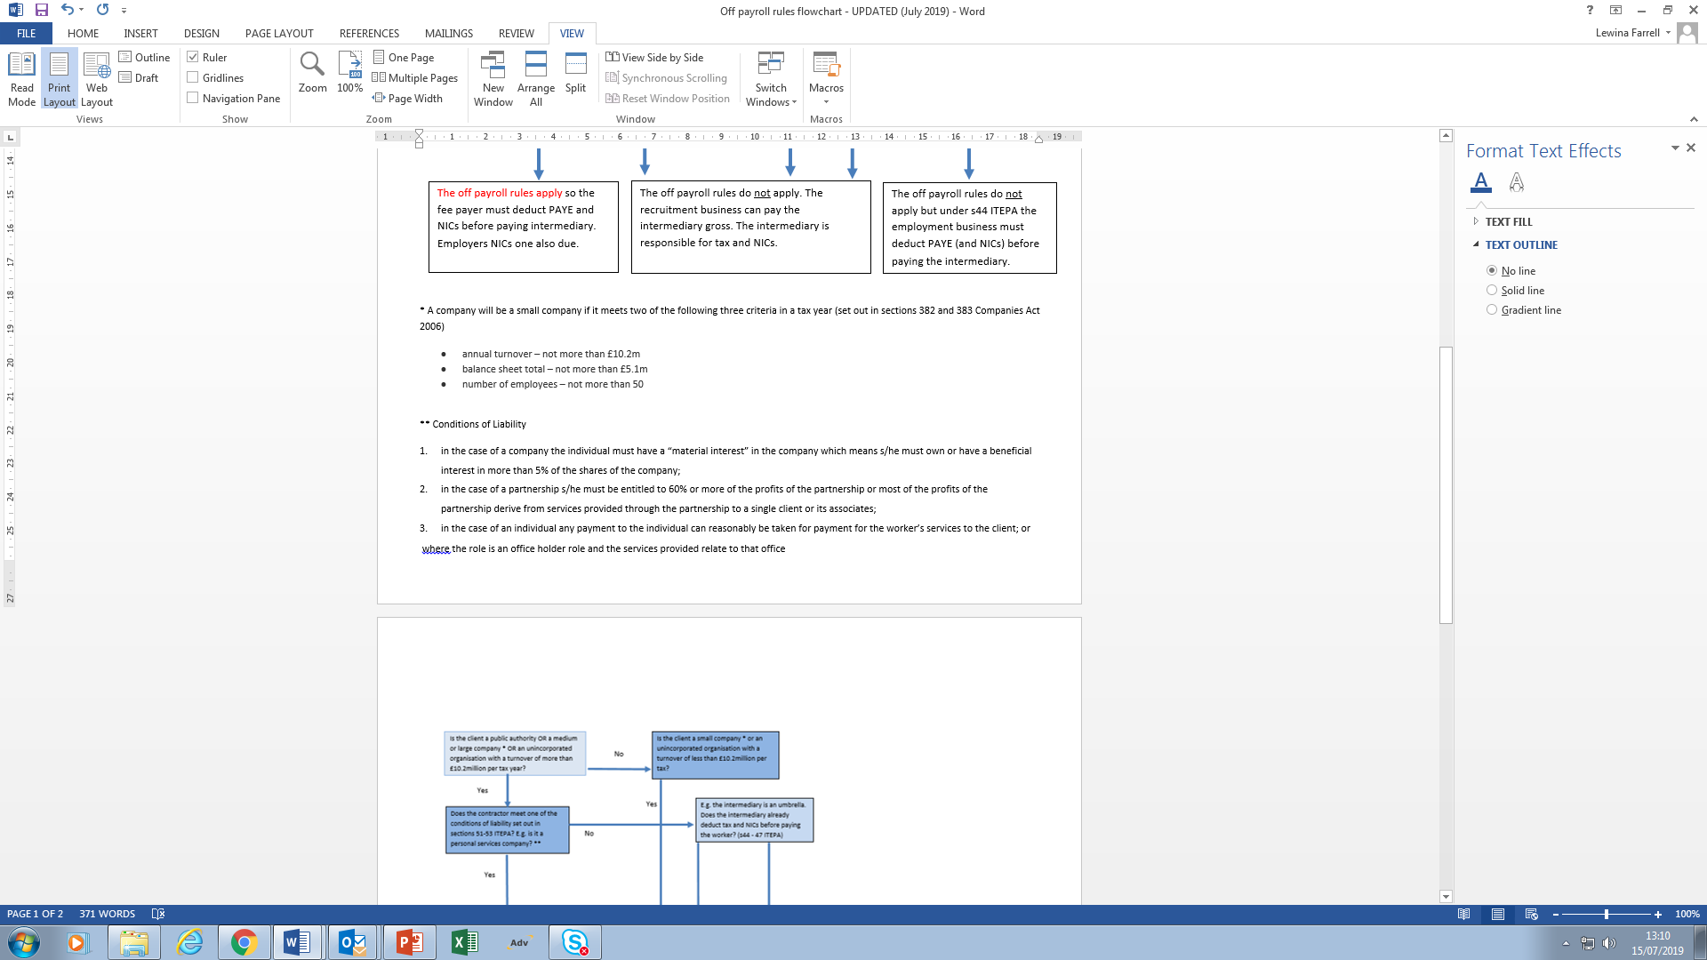
Extension of the off-payroll rules to the private sector
What rules will apply to the engagement from April 2020?
Notes:
Small companies test
Employee test – average number of employees employed in a year
Non-incorporated organisations:
2 options:
Apply the rules to organisations with 50 or more employees OR with turnover exceeding £10.2 million – so only need to meet one of the small company criteria
Apply the rules to organisations that have both 50 or more employees and turnover in excess of £10.2 million
(so in both scenarios avoiding the balance sheet condition. – don’t know why)
Again this is excessively complicated – option 1 will capture more organisations
In all of these scenarios the question is who makes the decision whether the company is exempt or not? Is the recruitment business to rely on a decision (or lack of decision) by the client? What if the client knows nothing about IR35 (shows need for comprehensive education programme).
When should this decision be made?
What happens if the decision is wrong?
What if the organisation does not tell whether it is a small company or not – good question and there is no answer to this in the consultation. We are raising it in our response document.

Slide 15
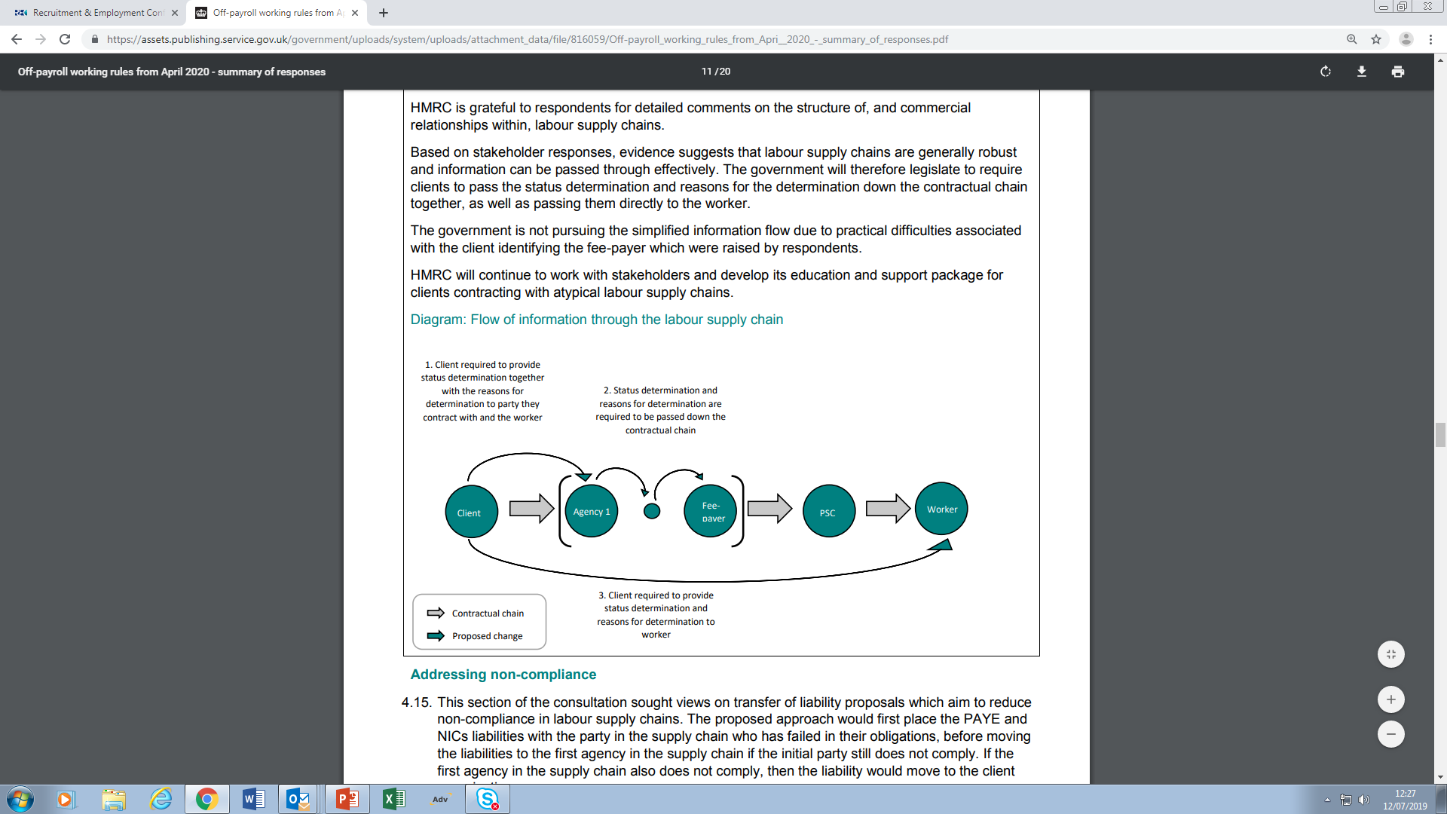
Extension of the off-payroll rules to the private sector
Diagram from Government’s Summary of Responses
Where the off payroll rules apply:
End user client will be responsible for making the IR35 status decision, not the intermediary (e.g. personal services company). Ideally before the contract starts or before the individual begins to provide their services (client liable until they pass the decision).
Client passes the status decision and the reasons for the decision to the party it has a contract with and the off-payroll worker.
Notes:
We have taken this diagram from the consultation document. It looks at how the IR35 status decision should be passed down through the supply chain.
Is there a contradiction between text (which states “on request”) and diagram which shows reasons being passed through the chain
Of course one issue is that the client does not have a direct contractual relationship with the individual. Also, may not know who the individual is at the outset or the arrangements through which they will work – they simply want a person or a task to be done.

Slide 16
Extension of the off-payroll rules to the private sector
Whatever tool the client uses it must take reasonable care, otherwise liability for unpaid tax and NICs will transfer to it.
HMRC’s Check your employment status for tax tool (CEST) – use is not mandatory but HMRC say they will stand by the decision given by the tool provided reasonable care is taken in making the decision (but see some news stories).
Commercial IR35 review companies – HMRC will not endorse any.
Blanket decisions? Beware – this is not reasonable care. But no specific reference in the legislation. Distinguish between:
  Client will not allow contractors to work through PSCs
  All engagements are “inside IR35”
  Client categorises roles and assesses those
Notes:
Blanket decision – e.g. everyone is inside or outside IR35.
Page 17 - “Not the same as applying a decision to a group of off-payroll workers with the same role, terms and contractual conditions which can be appropriate in some circumstances. However HMRC is clear that it is not right to rule all engagements to be within or outside of the rules irrespective of the contractual terms and actual working arrangements”
NB – recently reported that HMRC tried to have CEST decision disregarded as irrelevant

Slide 17

Extension of the off-payroll rules to the private sector
HMRC’s Check your employment status for tax tool (CEST) questions include:
who is completing the tool;
what type of intermediary the temporary worker works through;
whether the temporary worker can send a substitute and if they have ever exercised that right;
if the temporary worker is required to pay the substitute or if the employment business or public authority would pay them;
how much supervision, direction or control the public authority will exert on the temporary worker;
whether the temporary worker has to pay for any materials in order to provide their services;
whether the temporary worker is integrated into the client’s workforce.
The list above is not exhaustive but gives an idea of the question themes. HMRC will review CEST in preparation for the extension of the off-payroll rules.
Notes:
HMRC’s Check your employment status for tax tool (CEST) questions include:
who is completing the tool – any of the public authority, the employment business or the temporary worker can use the tool. However, the decision on status rests with the public authority;
what type of intermediary the temporary worker works through (personal services company, partnership or as a sole trader);
whether the temporary worker can send a substitute and if they have ever exercised that right;
if the temporary worker is required to pay the substitute or if the employment business or public authority would pay them;
how much supervision, direction or control the public authority will exert on the temporary worker;
whether the temporary worker has to pay for any materials in order to provide their services;
whether the temporary worker is integrated into the client’s workforce.

Slide 18
Extension of the off-payroll rules to the private sector
CEST * will give one of the following answers:
the temporary worker is an employee for tax purposes, which means that PAYE tax and NICs are due – i.e. INSIDE IR35 (therefore fee-payer must make deductions). Also pay employer NICs.
the temporary worker is self-employed for tax purposes, which means that the intermediary remains responsible for its own tax affairs – i.e. OUTSIDE IR35 (therefore fee-payer does not make deductions).
an indeterminate answer – DON’T KNOW.
* It is not mandatory to use CEST but HMRC have previously said that they will stand by the decision it gives provided the correct information was inputted. However ongoing case?
Notes:
It is not mandatory to use CEST and of course it has come in for a lot of criticism. HMRC are satisfied that the tool does what it needs to do but still are looking at how to improve it. REC IR35 working group have already submitted suggested amendments to HMRC.

Slide 19
Extension of the off-payroll rules to the private sector
Liability provisions:
When passing information down the supply chain, liability will move down the supply chain as each party fulfils its obligations. Liability will rest with a party that has failed to fulfil its obligations.
Unpaid monies - if HMRC unable to collect e.g. because the liable party ceases to exist, then liability moves back to agency 1 in the chain, and ultimately the client becomes liable.
NB – no personal liability or directors, office-holders or associates of fee-payers.
Notes:
Agency 1 would be the “specific intermediary” for ITEPA reporting (done quarterly).

Slide 20
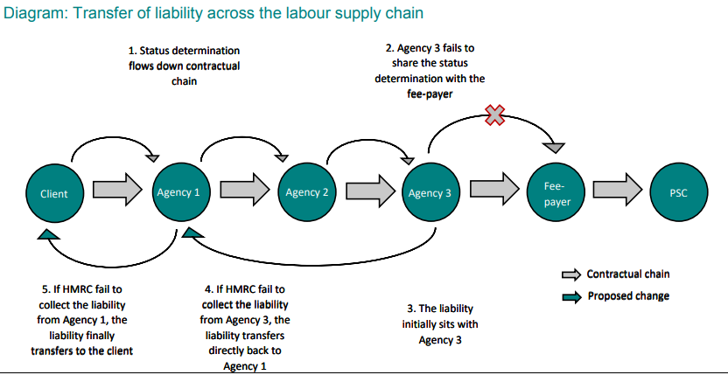
Extension of the off-payroll rules to the private sector
Diagram from Government’s Summary of Responses
Notes:
Agency 1 would be the “specific intermediary” for ITEPA reporting (done quarterly).

Slide 21

Extension of the off-payroll rules to the private sector
Client led disagreement process
Amended Section 61T ITEPA – the worker or deemed employer can make representations to the client that its status decision is incorrect.
Client must respond to those representations within 45 days of receipt confirming that its status decision is correct or not.
  √ If correct, the client must give reasons for its decision.
  X If the client changes its status decision, it must give a new status determination statement and confirm that previous statement is withdrawn.
  If the client fails to respond within 45 days it becomes the fee-payer.
  But no independent appeals process if there is still disagreement.
  NB – agencies should not substitute their own (or their contractors’ assessments) for those given by clients.
Notes:
Interesting given HMRC’s recent history and lack of success with IR35 cases. Including in particular against TV presenters – at the time of writing we are aware of HMRC having won only 1 out of 3 cases where the presenter challenged HMRC’s determination to pay employee taxes and NICs.

Slide 22
Extension of the off-payroll rules to the private sector
Misc (not stated in the legislation)
The feepayer will not be required to make deductions for student loans or pensions.
Double taxation – the PSC will be able to off-set the deemed payment against the remuneration from the PSC which would attract tax liabilities (for PSC/ off-payroll worker to manage).
Apprenticeship levy – remember, as payroll increases so does the apprenticeship levy bill. See REC campaign for reform of the apprenticeship levy.
What about employment status and AWR?
Notes:
Contractor workforce – how are contractors engaged,
This will increase payroll which will increase apprenticeship levy or bring even more recruiters into scope. There are already significant issues with recruiters not being able to access and use the substantial apprenticeship levy bills they pay for the benefit of their temporary workers.

Slide 23
Extension of the off-payroll rules to the private sector
Steps to take:
Clients to assess whether they will be affected by or exempt from the off-payroll rules, because they are a small company (or not) and record this assessment. If exempt, tell their agencies, explaining why. Monitor this periodically.
Clients to assess who amongst their contractor population might be affected by these changes and why. REC recommends that clients assess all roles filled by contractors, and not just those it identifies are filled on a given day by contractors working through their own personal services companies.
Identify who within their organisation can make IR35 status decisions and ensure that those individuals understand how to assess status and have the appropriate tools to do so. If there isn’t an internal person to do IR35 status decisions, then engage a well-established external reviewer.
Put processes in place to pass down the status decision and the reasons for that decision.
Work with agencies who will have their own processes to implement.
Agree with agencies how the increased employer costs will be met – agencies will not be able to simply absorb these costs and pay contractors the same rates.
Do not expect agencies to give unreasonable indemnities. They may not be able to insure against them.

Slide 24
Extension of the off-payroll rules to the private sector
The REC is all about brilliant recruitment, which drives our economy and delivers opportunity to millions. As the voice of the recruitment industry, we champion high standards, speak up for great recruiters, and help them grow. Recruitment is a powerful tool for companies and candidates to build better futures for themselves and a strong economy for the UK.
Find out more about the Recruitment & Employment Confederation at www.rec.uk.com .

Slide 25

Preparing For IR35 ?
Chris Humphreys
Partner
BHP, Chartered Accountants

Slide 26
Why Does it Matter ?
The numbers !
Only 1 in 10 caught by the off payroll rules are paying tax correctly.
Somebody with an income of £50,000 who works through their own company will contribute £6,000 more (of which £5,000 is employers NI)
£3bn for essential public services including the NHS
Estimated £550m per annum as a result of increased compliance in the Public Sector

Slide 27
Why Does it Matter ?
Back to the Numbers…
Daily rate £100.
37.5 hours per week for 44 weeks
Total contracting fees £22,000

Slide 28
Why Does it Matter ?
Current net monthly income £1,581
Inside IR35 revised net monthly income £1,541
Therefore need to increase daily rate by 3% to £103 to be no worse off.

Slide 29
Why Does it Matter ?
Feepayers costs increase by
  Employers NI at 13.8% = £153 per month
  Apprenticeship Levy at 0.5% = £9.17
Total annual increase £1,954
8.89% increase

Slide 30
Why Does it Matter ?
If feepayer keeps their cost the same by reducing the contract rate then:
  Effective reduction in rate to £92 per day.
  Net monthly income will reduce to £1,444.
  Daily rate needs to increase to £112 to be no worse off.

Slide 31
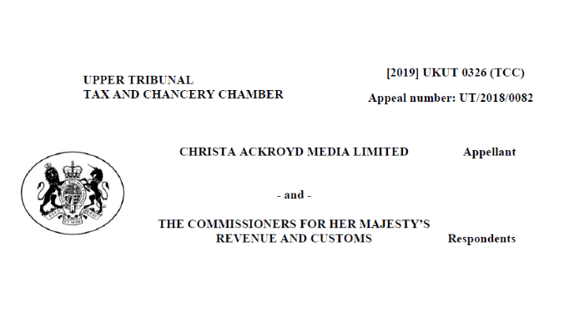
Why Does it Matter ?
Profile !

Slide 32

Why Does it Matter ?
Profile !

Slide 33

Why Does it Matter ?
Free the BBC Three !
Joanna Gosling, David Eades and Tim Wilcox
Split decision by FTT
Forced by BBC into working as contractors, through Personal Service Companies.

Slide 34
Why Does it Matter ?
Not your average IR35 case but….
Sufficient mutuality of obligation – referred to as being an irreducible minimum in IR35 case law.
Ultimate Control – presenter could only work for the BBC.
Obliged to provide services personally.

Slide 35


What may change ?
Blanket reclassifications.

Slide 36
What hasn’t changed ?
The tests !
IR35 rules have been in place since 2000.
HMRC concern is how these are being applied particularly in relation to Personal Service Companies.

Slide 37
What hasn’t changed ?
Control: Is the worker free to work as they wish? For example, are they required to work from a certain location or at certain times of the day at the request of the client?
Financial risk: Is there a personal financial risk incurred as a result of the performance of work duties? Employees rarely risk financial loss by being employed, whereas if a worker buys assets such as PC's, laptops, servers, printers, office equipment or a client fails to pay, a contractor or freelancer will most definitely experience financial loss.
Substitution: Is there a clause in the contract around using somebody else to perform the task given to the worker? Is someone else allowed to step in and cover the job?
Provision of equipment: Will the worker be using their own equipment? Sometimes this can be difficult with organisations stipulating that company-owned equipment must be used at all times. Allowances can be made where security measures prohibit the use of someone using their own laptop for example.
The right of dismissal: Does the worker have a fixed notice period? HMRC will argue that this is like an employee, therefore there should be a provision in the contract for immediate termination should the client choose to do so.
Employee benefits: In simple terms, receiving holiday pay, sick pay, pension contributions and training courses are all no-go areas. These benefits should only apply to employees of the company – not contractors or freelancers

Slide 38
Importance of CEST
Updated Check Employer Status Test will be available in the New Year.
Aids with the creation of Status Determination Statements.
Evidence that have taken reasonable care

Slide 39

Importance of CEST

Slide 40

Importance of CEST

Slide 41

Importance of CEST

Slide 42

Importance of CEST

Slide 43

Importance of CEST

Slide 44

Importance of CEST

Slide 45

Importance of CEST

Slide 46

Importance of CEST

Slide 47
The way forward ?
Status Determination Statements.
Appeals within time limits if required.
Rate negotiation if reclassified ?
Members Voluntary Liquidation of Personal Service Company

Slide 48
This presentation and any accompanying notes are provided as information only and should not be relied upon as advice, or treated as such. No liability is accepted for any errors of fact or opinion they may contain. Professional advice should always be sought before making any decisions.
Chris Humphreys
BHP LLP
chris.humphreys@bhp.co.uk
BHP, Chartered Accountants 2019. All rights reserved
BHP, Chartered Accountants is a trading name of BHP LLP

Slide 49
Thank you for attending

